Slide 1
Quantifying uncertainty
Session 09
Henry Lucky, S.Kom., M.Kom.

Slide 2
Learning Outcomes
Session 9
At the end of this session, students will be able to:
LO 4: Apply various techniques to an agent when acting under uncertainty

Slide 3
outline
Session 9
Probability
Random Variables
Probability Distributions
The Chain Rule
Bayes Rule

Slide 4
Probability
uncertainty
The real world is rife with uncertainty!
  E.g., if I leave for SFO 60 minutes before my flight, will I be there in time?
Problems:
  partial observability (road state, other drivers’ plans, etc.)
  noisy sensors (radio traffic reports, Google maps)
  immense complexity of modelling and predicting traffic, security line, etc.
  lack of knowledge of world dynamics (will tire burst? will I get in crash?)

Slide 5
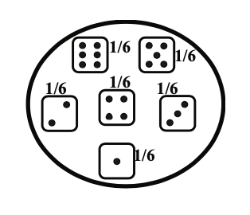
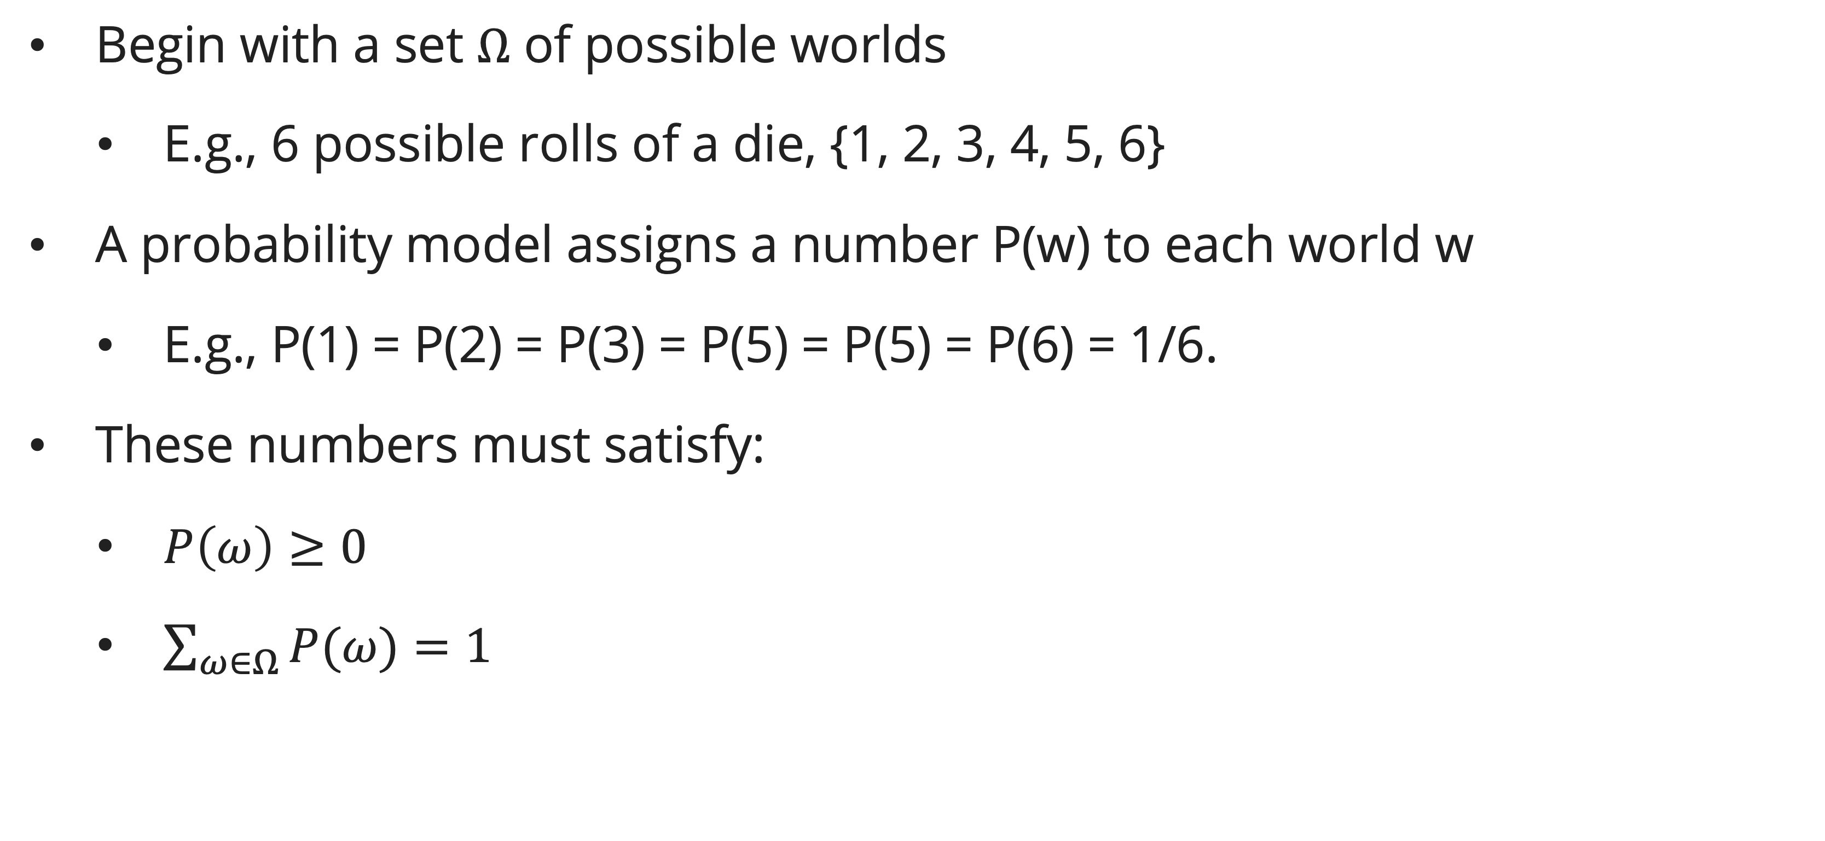
Probability
Basic laws of probability (discrete)
Begin with a set $Ω$ of possible worlds
  E.g., 6 possible rolls of a die, {1, 2, 3, 4, 5, 6}
A probability model assigns a number P(w) to each world w
  E.g., P(1) = P(2) = P(3) = P(5) = P(5) = P(6) = 1/6.
These numbers must satisfy:
  $P\left(ω\right)≥0$
  $\sum_{ω∈Ω}{P(ω)}=1$

Slide 6
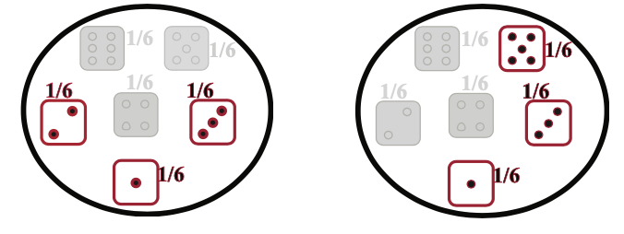
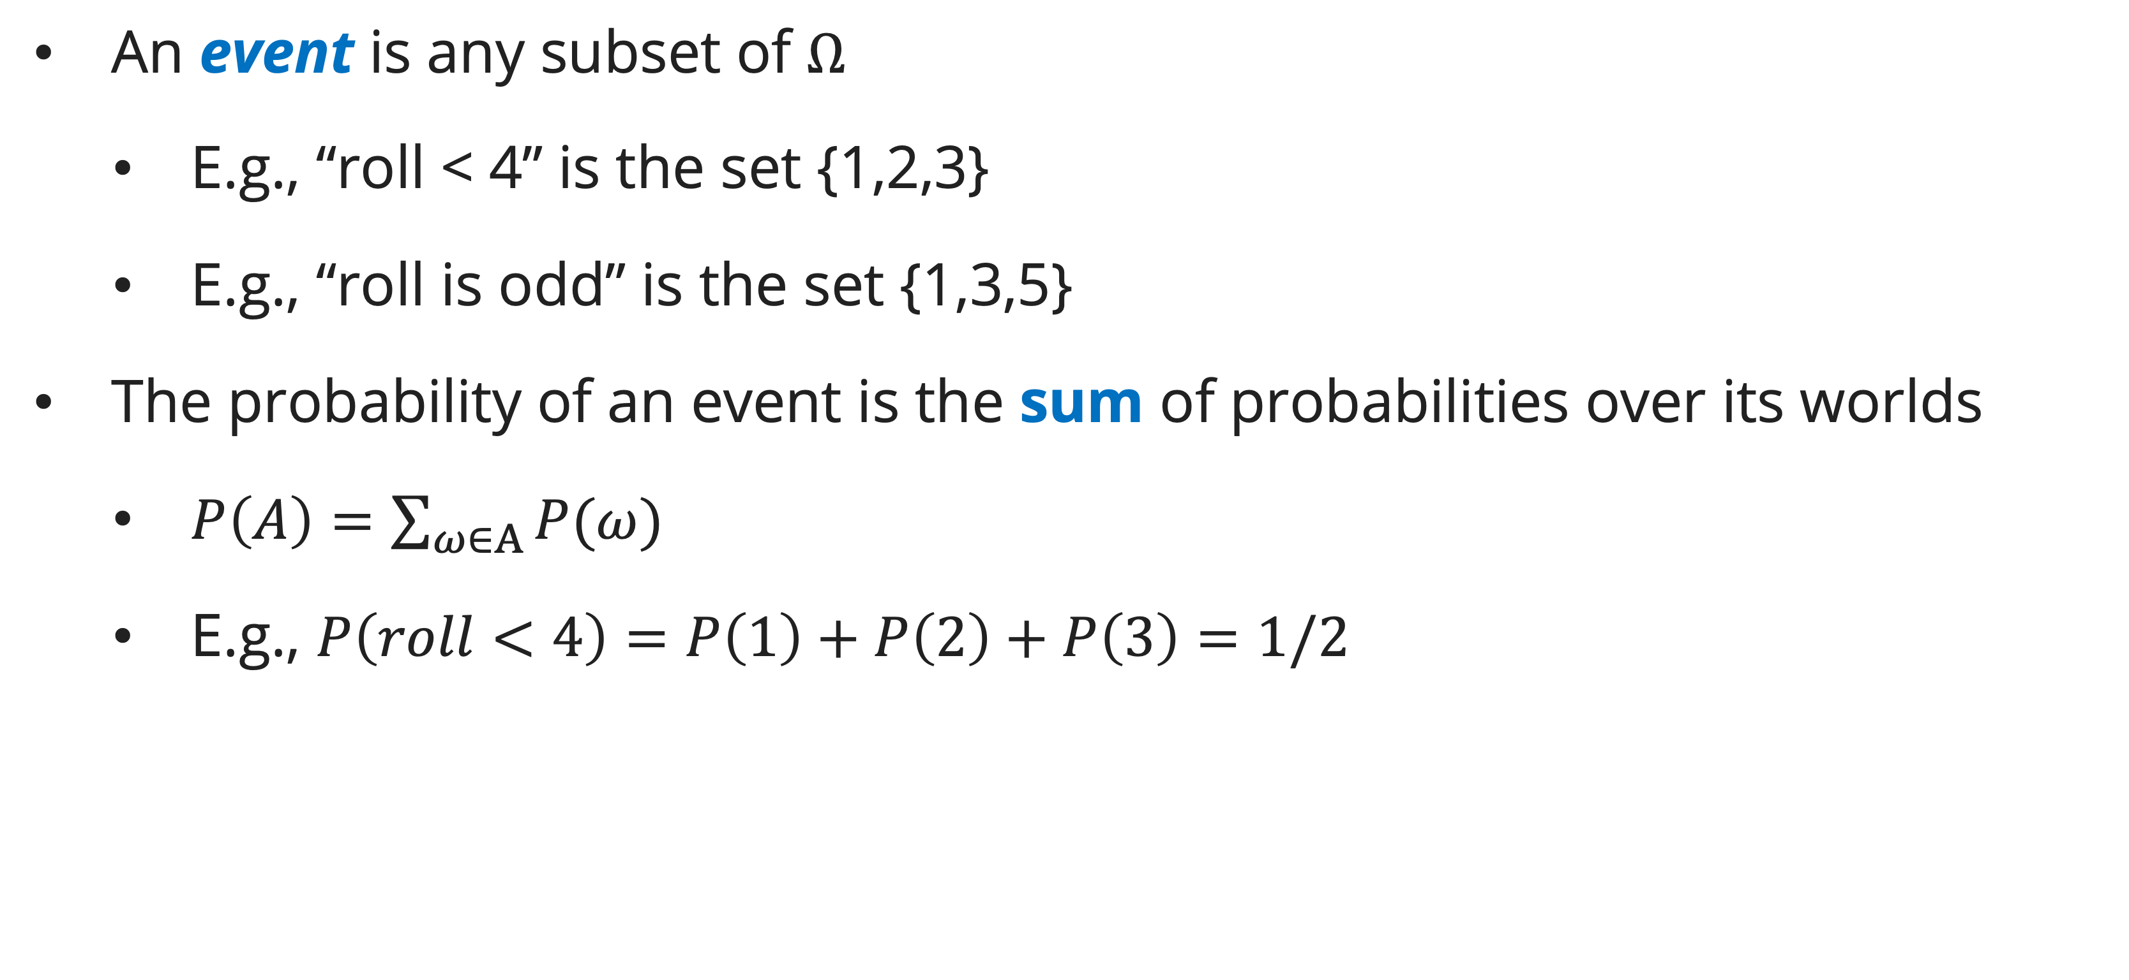
Probability
Basic laws of probability (discrete)
An event is any subset of $Ω$
  E.g., “roll < 4” is the set {1,2,3}
  E.g., “roll is odd” is the set {1,3,5}
The probability of an event is the sum of probabilities over its worlds
  $P\left(A\right)=\sum_{ω∈A}{P(ω)}$
  E.g., $P\left(roll<4\right)=P\left(1\right)+P\left(2\right)+P\left(3\right)=1/2$

Slide 7
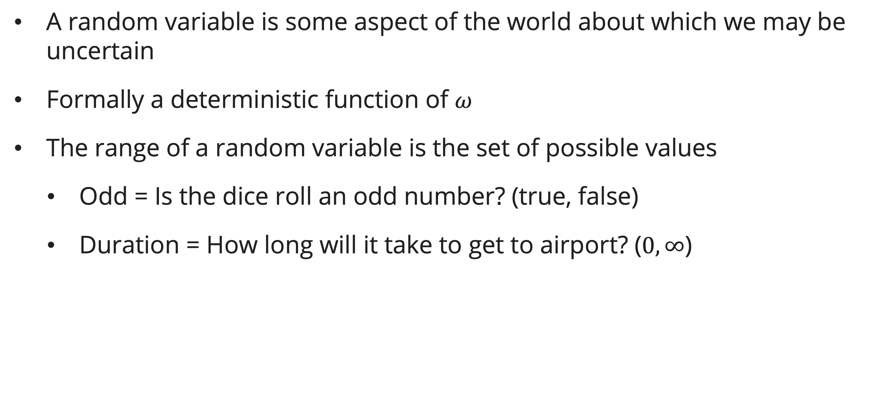
Random variables
definition
A random variable is some aspect of the world about which we may be uncertain
Formally a deterministic function of $ω$
The range of a random variable is the set of possible values
  Odd = Is the dice roll an odd number? (true, false)
  Duration = How long will it take to get to airport? ($0, ∞$)

Slide 8
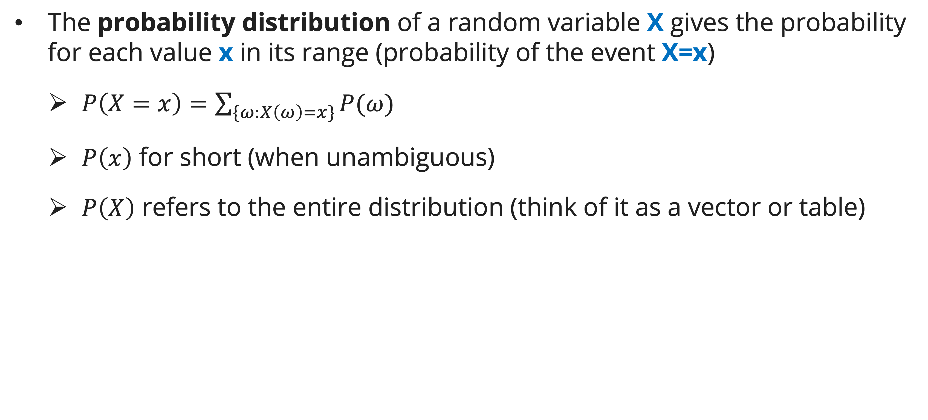
Random variables
definition
The probability distribution of a random variable X gives the probability for each value x in its range (probability of the event X=x)
  $P\left(X=x\right)=\sum_{\{ω:X\left(ω\right)=x\}}{P(ω)}$
  $P\left(x\right)$ for short (when unambiguous)
  $P\left(X\right)$ refers to the entire distribution (think of it as a vector or table)

Slide 9
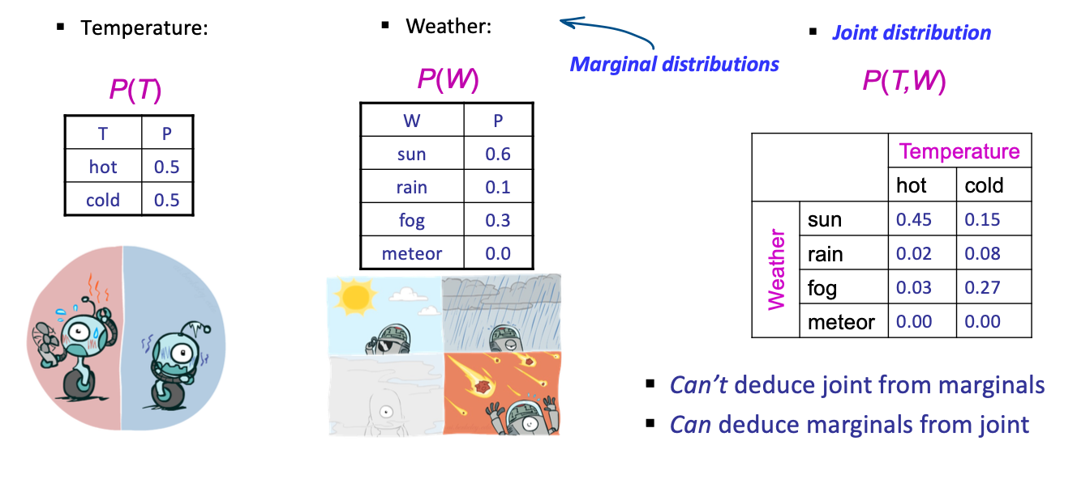
Probability distributions
definition
Associate a probability with each value; sums to 1

Slide 10
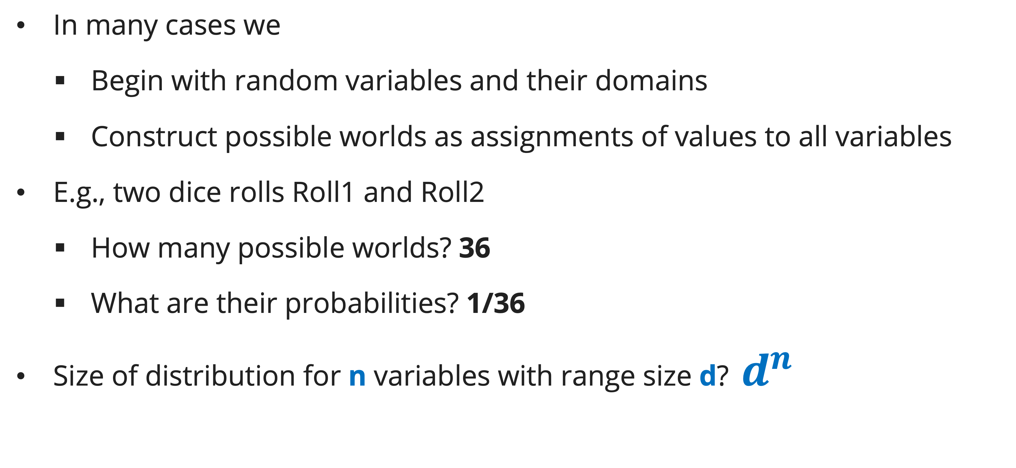
Probability distributions
Making possible words
In many cases we
  Begin with random variables and their domains
  Construct possible worlds as assignments of values to all variables
E.g., two dice rolls Roll1 and Roll2
  How many possible worlds? 36
  What are their probabilities? 1/36
Size of distribution for n variables with range size d? $d^{n}$

Slide 11
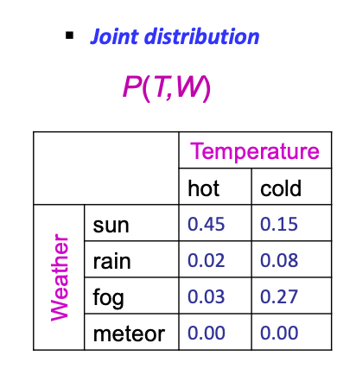
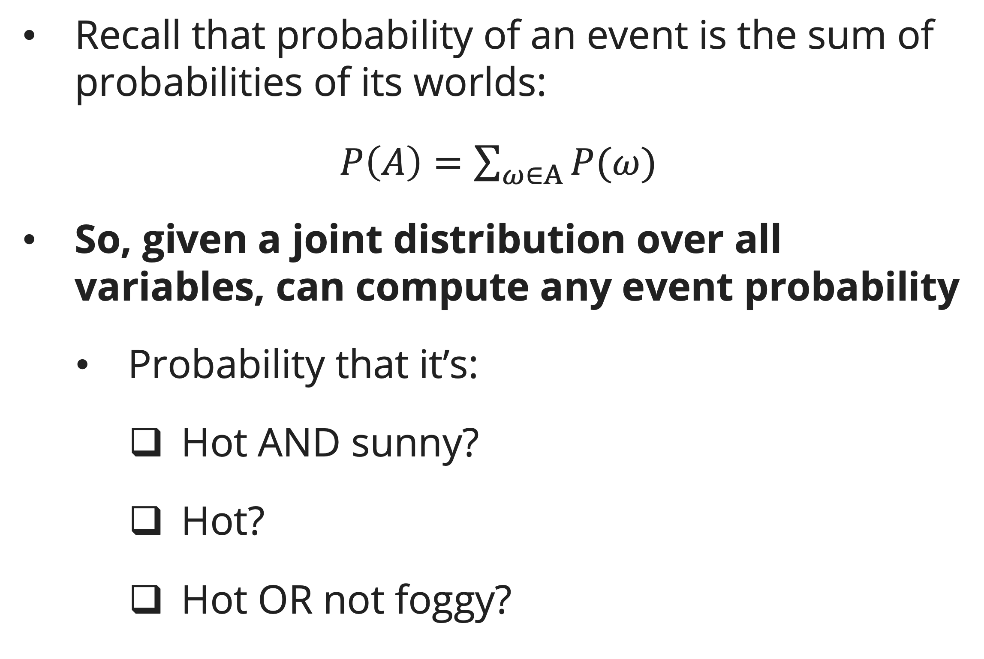
Probability distributions
Probabilities of events
Recall that probability of an event is the sum of probabilities of its worlds:
$P\left(A\right)=\sum_{ω∈A}{P(ω)}$
So, given a joint distribution over all variables, can compute any event probability
  Probability that it’s:
    Hot AND sunny?
    Hot?
    Hot OR not foggy?

Slide 12
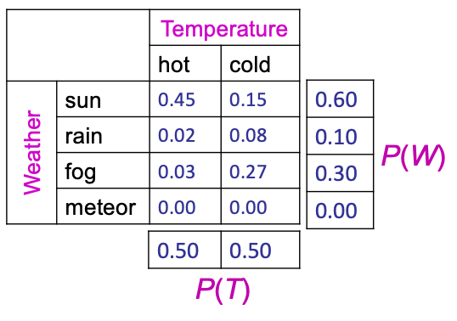
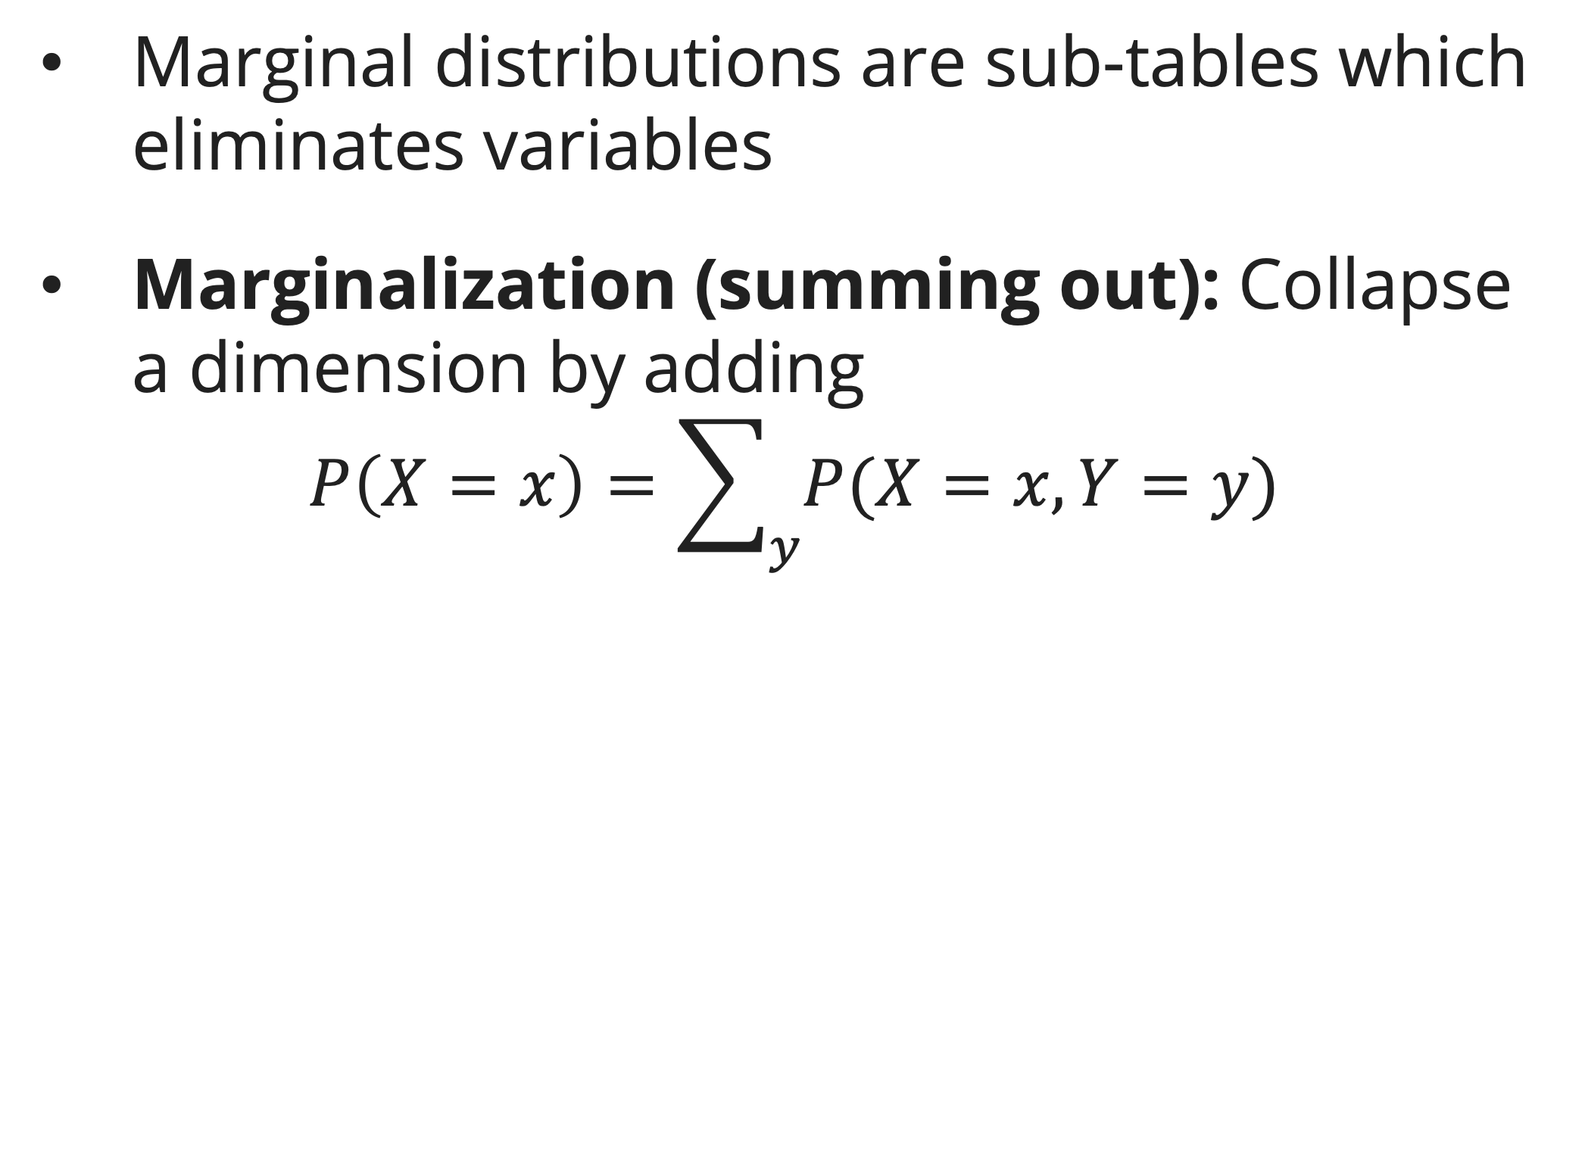
Probability distributions
Marginal distributions
Marginal distributions are sub-tables which eliminates variables
Marginalization (summing out): Collapse a dimension by adding
$$P\left(X=x\right)=\sum_{y}{P(X=x, Y=y)}$$

Slide 13
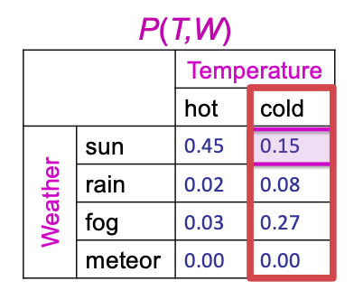

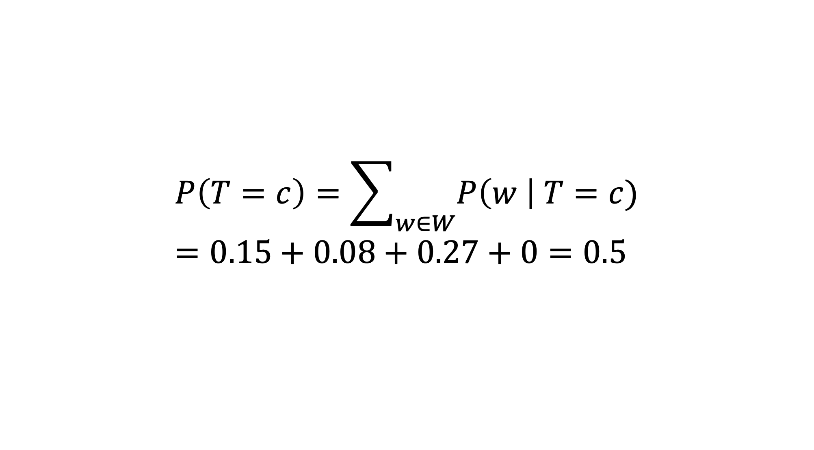
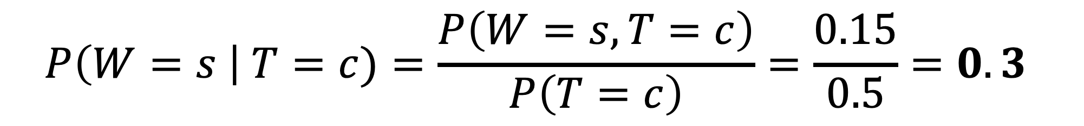
Probability distributions
Conditional probabilities
A simple relation between joint and conditional probabilities
$$P\left(a \right| b)=\frac{P\left(a,b\right)}{P\left(b\right)}$$
$$P\left(W=s \right| T=c)=\frac{P\left(W=s,T=c\right)}{P\left(T=c\right)}=\frac{0.15}{0.5}=0.3$$
$$P\left(T=c\right)=\sum_{w∈W}{P\left(w \right| T=c)}=0.15+0.08+0.27+0=0.5$$

Slide 14
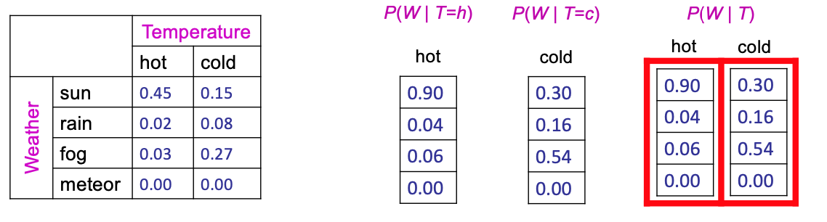
Probability distributions
Conditional distributions
Distributions for one set of variables given another set

Slide 15
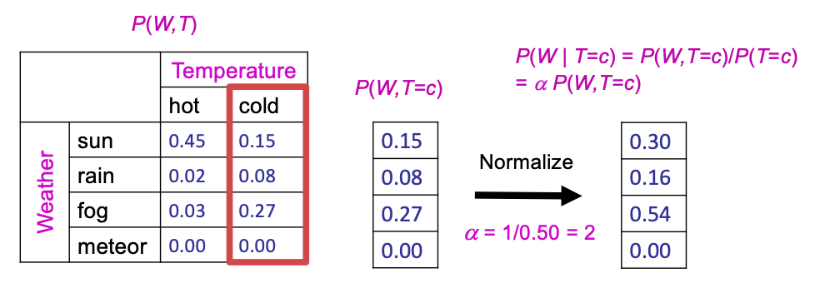

Probability distributions
Conditional distributions: Normalizing
Normalizing distribution: to bring or restore a normal condition (all entries sum to ONE)
Procedure: Multiply each entry by $α=1/(sum of all entries)$

Slide 16

Probability distributions
The product rule
Sometimes have conditional distributions but want the joint
$$P\left(a \right| b) P(b)=P(a,b)$$
$$P\left(a \right| b)=\frac{P\left(a,b\right)}{P\left(b\right)}$$

Slide 17
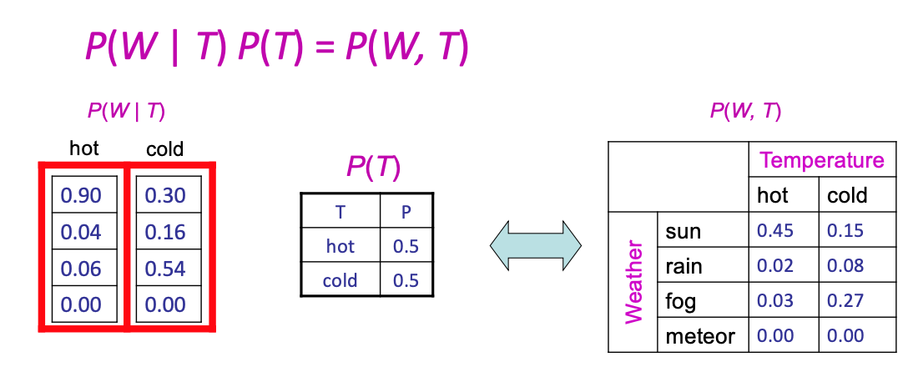
Probability distributions
The product rule: example

Slide 18
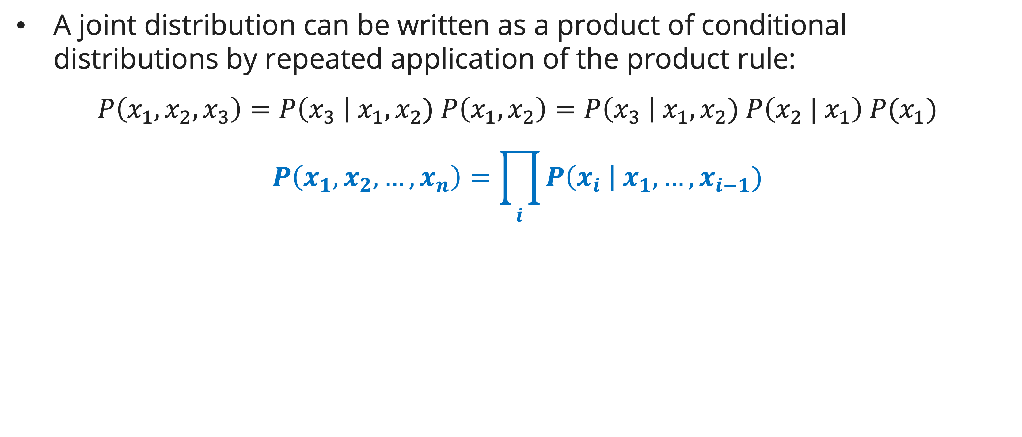
The chain rule
definition
A joint distribution can be written as a product of conditional distributions by repeated application of the product rule:
$$P\left(x_{1},x_{2},x_{3}\right)=P\left(x_{3} \right| x_{1}, x_{2}) P\left(x_{1}, x_{2}\right)=P\left(x_{3} \right| x_{1}, x_{2}) P\left(x_{2} | x_{1}\right) P(x_{1})$$
$$P\left(x_{1},x_{2},…,x_{n}\right)=\prod_{i}{P\left(x_{i} \right| x_{1}, …, x_{i−1})}$$

Slide 19
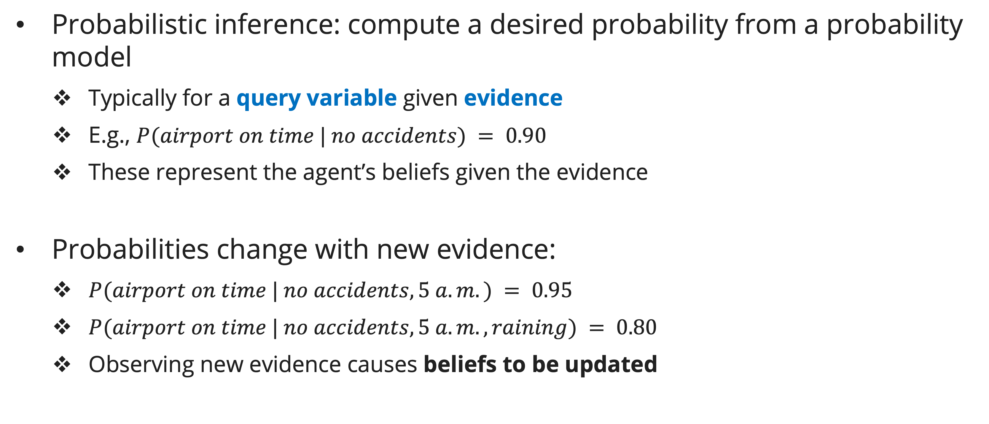
Bayes’ rule
Probabilistic inference
Probabilistic inference: compute a desired probability from a probability model
  Typically for a query variable given evidence
  E.g., $P(airport on time | no accidents) = 0.90$
  These represent the agent’s beliefs given the evidence
Probabilities change with new evidence:
  $P(airport on time | no accidents, 5 a.m.) = 0.95$
  $P(airport on time | no accidents, 5 a.m., raining) = 0.80$
  Observing new evidence causes beliefs to be updated

Slide 20
Bayes’ rule
Evidence variables: $e_{1}..e_{k}$
Query variable: $Q$
Hidden variables: $H_{1}..H_{r}$
Probabilistic inference by enumeration
Let’s say we want:
$$P\left(Q \right| e_{1}..e_{k})$$
Step 1: Select the entries consistent with evidence
Step 2: Sum out H to get joint of Query and evidence
$$P(Q, e_{1}..e_{k})=\sum_{h_{1}…h_{r}}{P\left(Q, h_{1}…h_{r},e_{1}…e_{k}\right)}$$
Step 3: Normalize:
$$α=\frac{1}{\sum_{q}{P(Q, e_{1}...e_{k})}}=\frac{1}{P(e_{1}...e_{k})}$$
$$P\left(Q \right| e_{1}…e_{k})=α P(Q, e_{1}…e_{k})$$

Slide 21
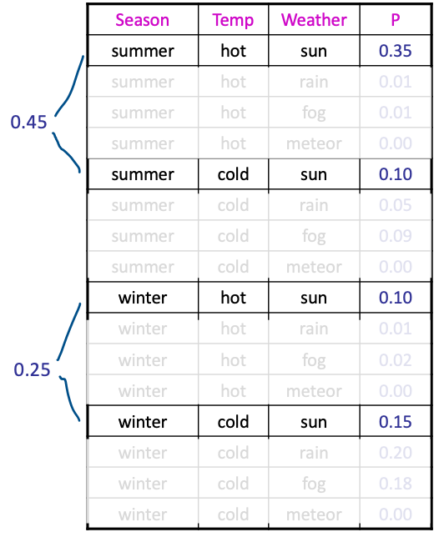
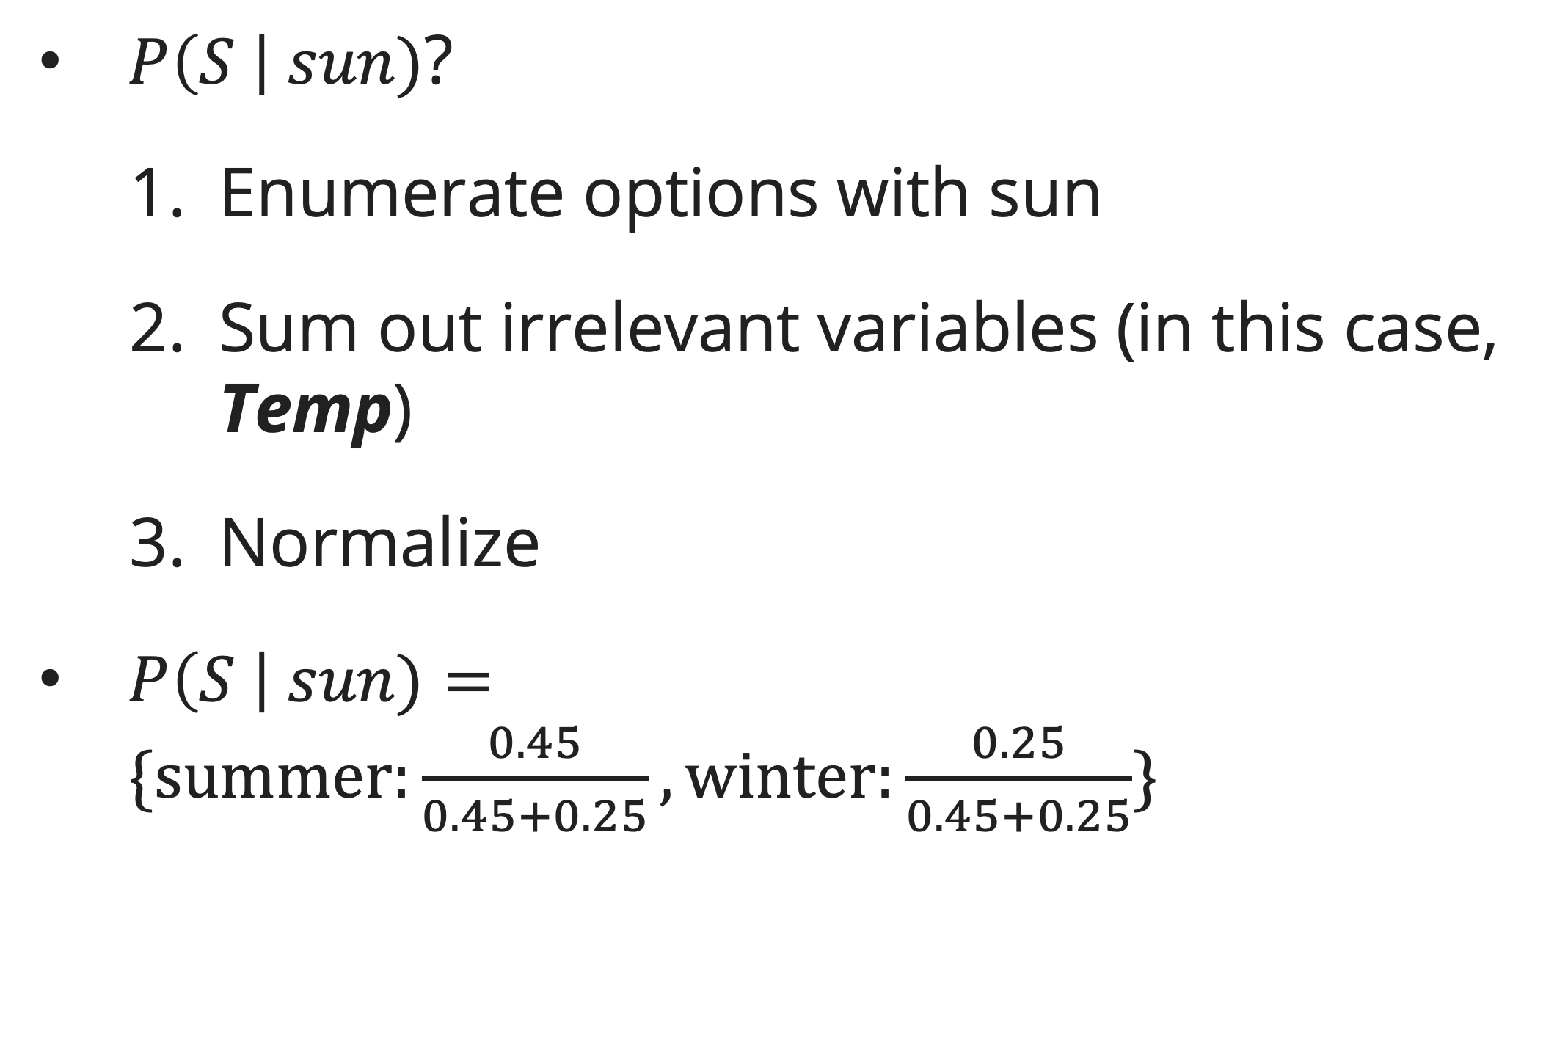
Bayes’ rule
Probabilistic inference by enumeration
$P\left(S \right| sun)$?
  Enumerate options with sun
  Sum out irrelevant variables (in this case, Temp)
  Normalize
$P\left(S \right| sun)=\{summer:\frac{0.45}{0.45+0.25}, winter:\frac{0.25}{0.45+0.25}\}$

Slide 22

Bayes’ rule
Probabilistic inference by enumeration
Obvious problems:
  Worst-case time complexity $O\left(d^{n}\right)$ (exponential in # hidden vars)
  Space complexity $O\left(d^{n}\right)$ to store the joint distribution
  $O\left(d^{n}\right)$ data points to estimate the entries in the joint distribution

Slide 23
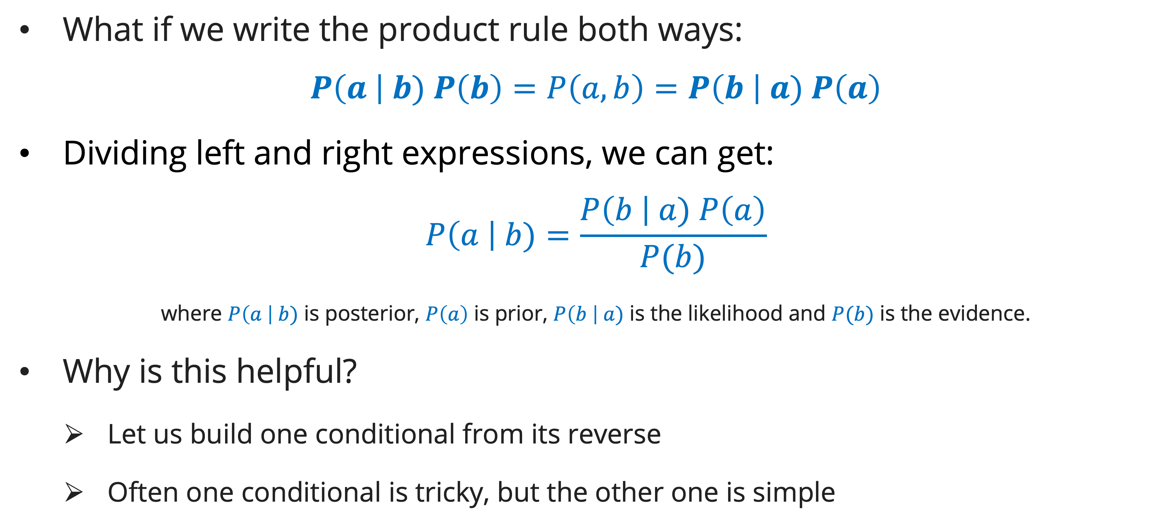
Bayes’ rule
definition
What if we write the product rule both ways:
$$P\left(a \right| b) P\left(b\right)=P\left(a,b\right)=P\left(b \right| a) P\left(a\right)$$
Dividing left and right expressions, we can get:
$$P\left(a \right| b)=\frac{P\left(b \right| a) P\left(a\right)}{P(b)}$$
where $P\left(a \right| b)$ is posterior, $P\left(a\right)$ is prior, $P\left(b \right| a)$ is the likelihood and $P(b)$ is the evidence.
Why is this helpful?
  Let us build one conditional from its reverse
  Often one conditional is tricky, but the other one is simple

Slide 24
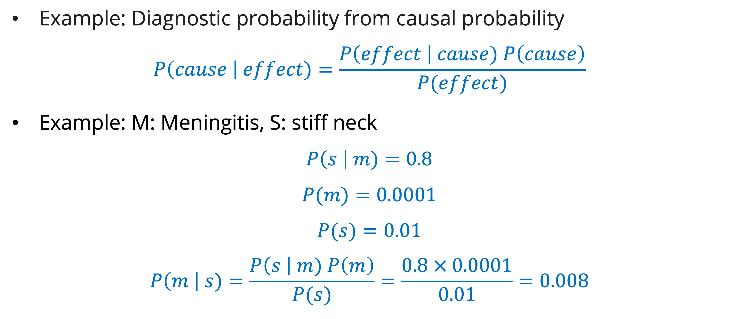
Bayes’ rule
Inference with bayes’ rule
Example: Diagnostic probability from causal probability
$$P\left(cause \right| effect)=\frac{P\left(effect \right| cause) P\left(cause\right)}{P(effect)}$$
Example: M: Meningitis, S: stiff neck
$$P\left(s \right| m)=0.8$$
$$P(m)=0.0001$$
$$P(s)=0.01$$
$$P\left(m \right| s)=\frac{P\left(s \right| m) P\left(m\right)}{P(s)}=\frac{0.8 × 0.0001}{0.01}=0.008$$

Slide 25
exercise
Probability inference
Marie is getting married tomorrow, at an outdoor ceremony in the desert. In recent years, it has rained only 5 days each year. Unfortunately, the weatherman has predicted rain for tomorrow. When it actually rains, the weatherman correctly forecasts rain 90% of the time. When it doesn't rain, he incorrectly forecasts rain 10% of the time. What is the probability that it will rain on the day of Marie's wedding?

Slide 26
References
Session 9
Peter Norvig, Stuart Russel. (2021). Artificial Intelligence: A Modern Approach. Pearson. London. ISBN: 978-1292401133. Ch. 12-13.
Dan Klein and Pieter Abbeel. (2024). CS188 Intro to AI at UC Berkeley
Stephanie Rosenthal. (2023). CMU AI and http://ai.berkeley.edu

